Slide 1
生物信息中的统计模型
生物信息中的统计模型 （2016年春）
2016年春

Slide 2
有关信息
邓明华
Email: dengmh@pku.edu.cn
Office: 北京大学理科一号楼1579E
Phone: 62767562, 13522856599
课程网页

Slide 3
考评
平时作业：20%
期末Project：80%
以下PPT部分来源于
Zhaohui Qin( University of Emory)
2011年北京大学统计中心暑期课程第一讲

Slide 4
Bioinformatics
Bioinformatics is the research, development, or application of computational tools and approaches for expanding the use of biological, medical, behavioral or health data, including those to acquire, store, organize, archive, analyze, or visualize such data;
Computational biology is the development and application of data-analytical and theoretical methods, mathematical modeling and computational simulation techniques to the study of biological, behavioral, and social systems.

Slide 5
Bioinformatics
Overlay of Biology, Computer science and Statistics.
Topics:
Sequence alignment
Protein folding
Gene finding
Functional annotation
Network inference

Slide 6
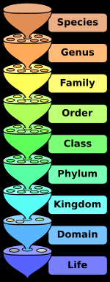
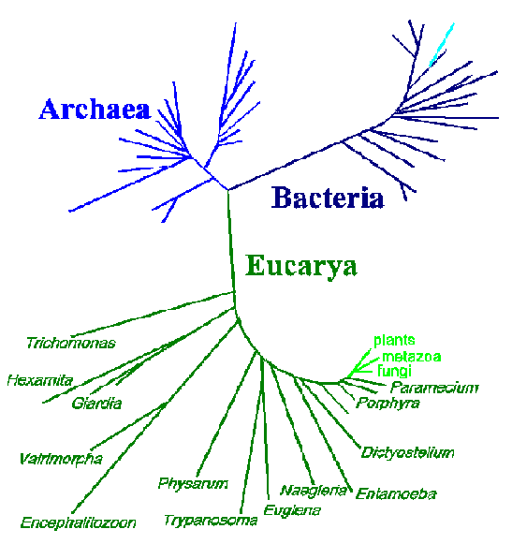
Tree of Life
modified from N.R. Pace, ASM News 62:464, 1996

Slide 7
Molecules of Life
DNA
RNA
Protein

Slide 8
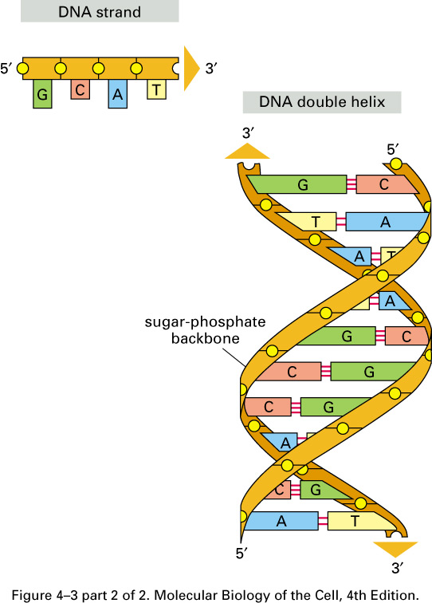
DNA
Deoxyribonucleic acid(脱氧核糖核酸)
Consist of four nucleotides
A Adenine(腺嘌呤)
C Cytosine(胞嘧啶)
G Guanine(鸟嘌呤)
T Thymine(胸腺嘧啶)

Slide 9
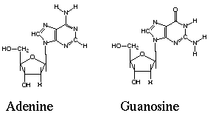
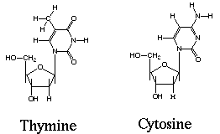
DNA
Purines (嘌呤)
Pyrimidines(嘧啶)

Slide 10
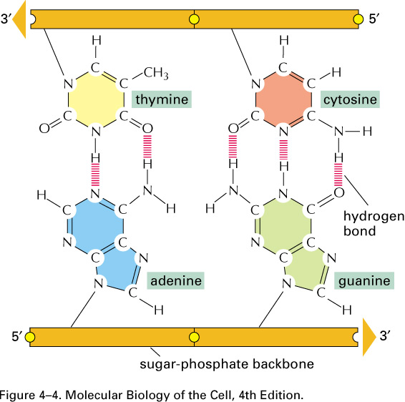
Base Pairing

Slide 11
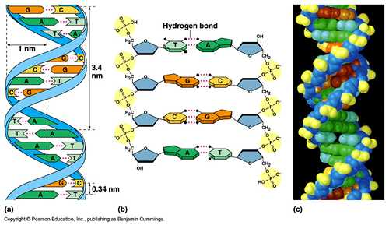
Structure of DNA

Slide 12
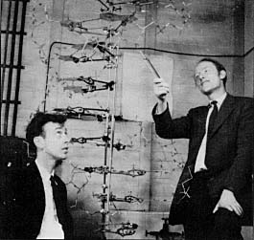
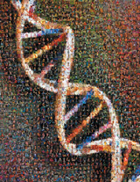
DNA Structure

Slide 13
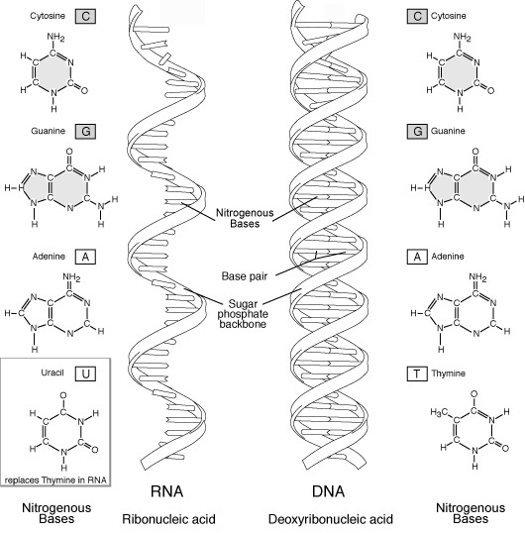
RNA

Slide 14
RNA
Ribonucleic acid (核糖核酸)
mRNA : Messenger RNAs, code for proteins
rRNA: Ribosomal RNAs, form the basic structure of the ribosome and catalyze protein synthesis.
tRNA: Transfer RNAs, central to protein synthesis as adaptors between mRNA and amino acids.

Slide 15
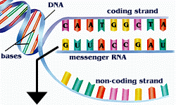
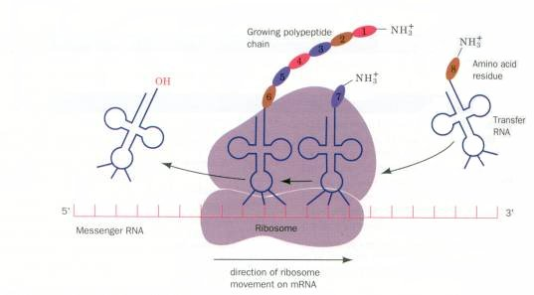
mRNA and tRNA
Transcription
Translation

Slide 16
Proteins
Main building blocks and functional molecules, take up ~20% of eukaryotic cell’s weight.
Structural proteins
Enzymes
Antibodies
Transmembrane proteins

Slide 17
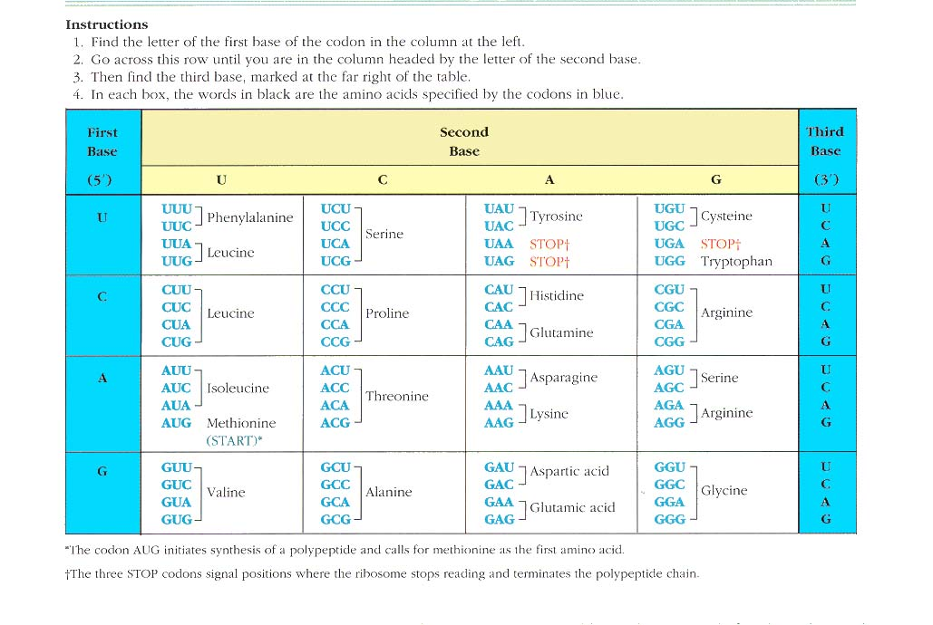
Genetic Code
Marshall Nirenberg, 1966

Slide 18
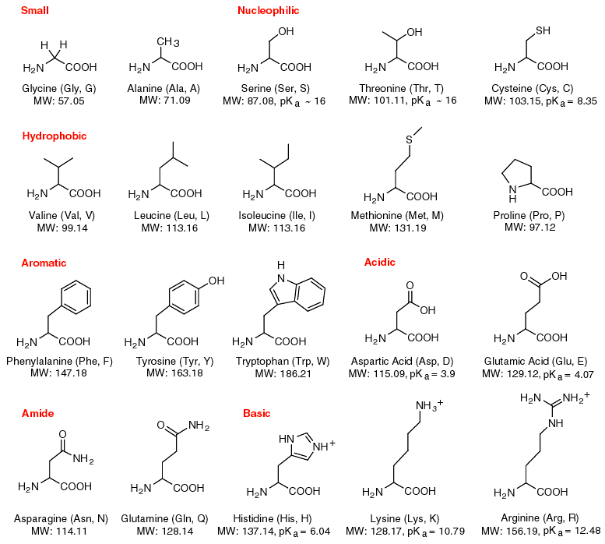
Amino Acids
Amino Acids are compounds
that contain both an amino
group (-NH3+) and a carboxy
acid group (-COO-). 19 of the
20 amino acids fit this rule,
and in addition, have a single carbon atom between these
two groups, and a variable extension off this carbon
atom. The exception is
proline.

Slide 19
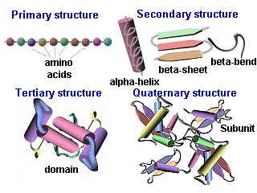
Protein Structure

Slide 20
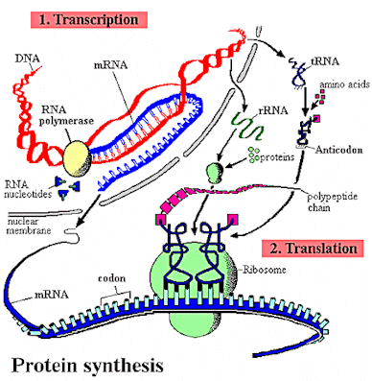
The Central Dogma
DNA→RNA→Protein

Slide 21
Prokaryotic Genes
Prokaryotes (intronless protein coding genes)
Upstream (5’)
Gene region
promoter
TAC
Downstream (3’)
DNA
Transcription (gene is encoded on minus strand .. And the reverse complement is read into mRNA)
ATG
mRNA
5´ UTR
CoDing Sequence (CDS)
3´ UTR
ATG
Translation: tRNA read off each codons, 3 bases at a time, starting at start codon until it reaches a STOP codon.
protein

Slide 22
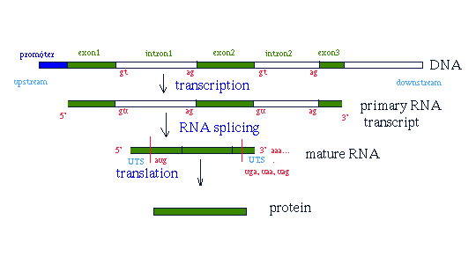
Eukaryotic Genes

Slide 23
Transcription
Process of copying DNA to RNA
Differs from DNA synthesis in that only one strand of DNA, the template strand, is used to make mRNA
Does not need a primer to start
Can involve multiple RNA polymerases
Divided into 3 stages
Initiation
Elongation
Termination

Slide 24
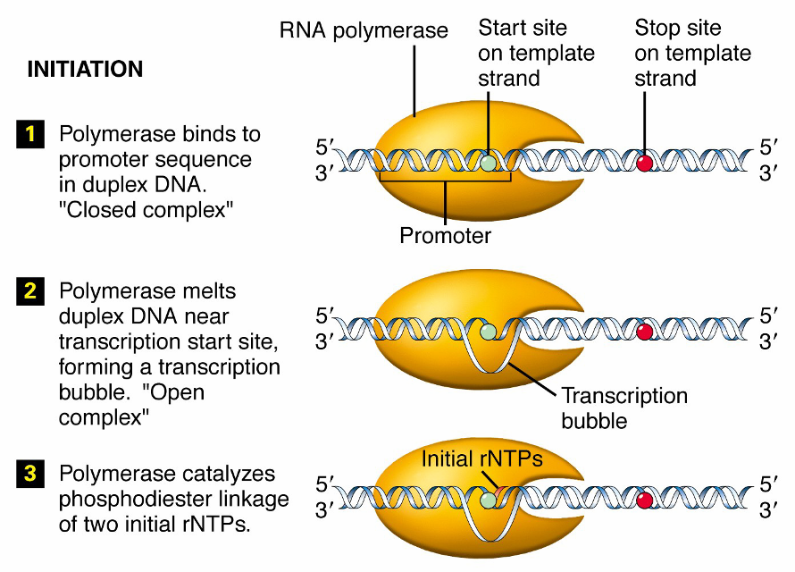

Slide 25
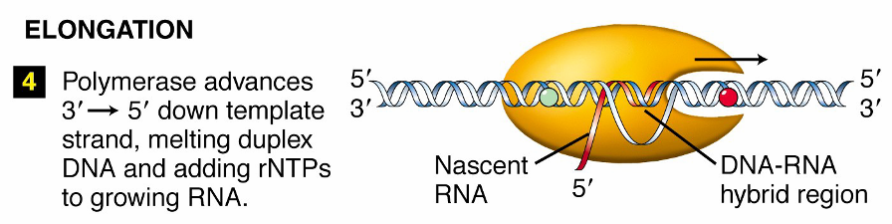

Slide 26
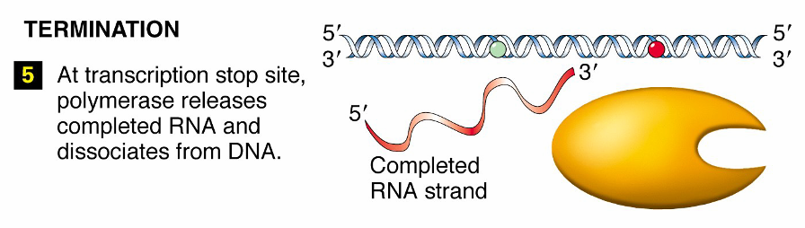

Slide 27
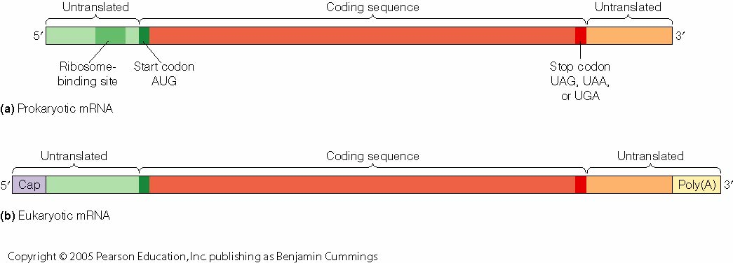
Transcription: The final product

Slide 28
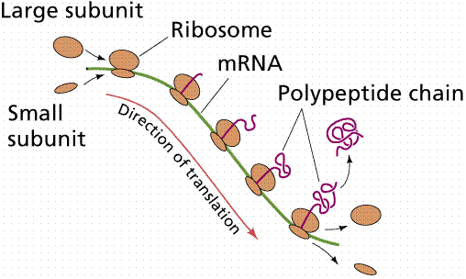
Translation

Slide 29
课程安排
生物背景和课程简介
概率论基础
Hidden Markov Model (HMM)及其应用
Markov Chain
HMM理论
HMM和基因识别 (Topic I)
HMM和序列比对 (Topic II)
进化树的概率模型 (Topic III )
Motif finding中的概率模型 (Topic IV)
EM algorithm
Markov Chain Monte Carlo (MCMC)
基因表达数据分析 (Topic V)
聚类分析-Mixture model
Classification-Lasso Based variable selection
基因网络推断 (Topic VI)
Bayesian网络
Gaussian Graphical Model
基因网络分析 (Topic VII)
Network clustering
Network Motif
Markov random field (MRF)
Dimension reduction及其应用 (Topic VIII)

Slide 30
Topic I: Sequence’s Feature Detection
Problem I: CpG island finding
Problem II: Gene finding (promoter prediction, Splicing site prediction, Translation Initial Site Prediction etc.)
Hidden Markov Model is a powerful method for these problems

Slide 31
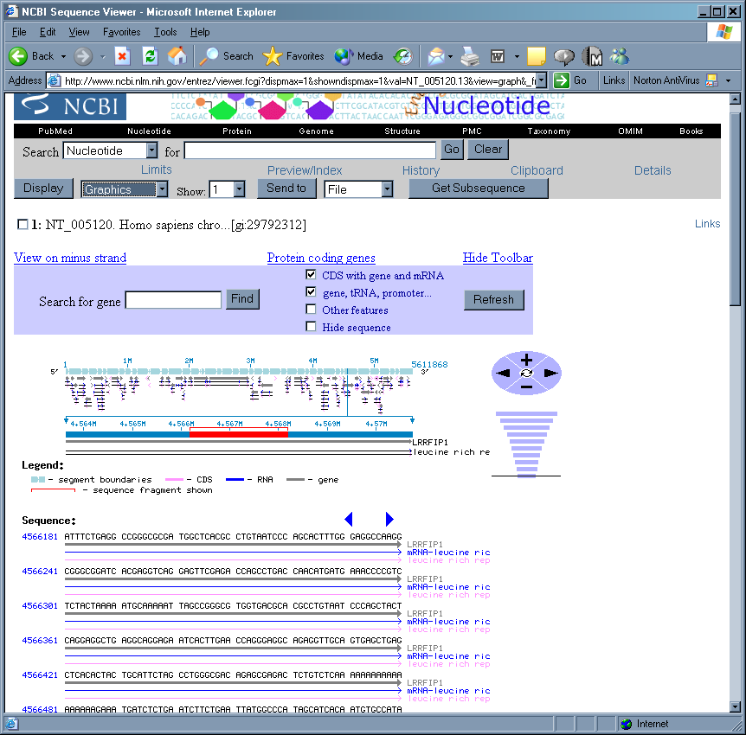
什么是CpG岛？
CG-poor regions: P(CG) ~ 0.07!
CG-rich region: P(CG) ~ 0.25
……
Gene coding region
Promoter region

Slide 32
CpG岛的生物学意义
CpG-rich regions are associated with genes which are frequently transcribed.
Helps to understand gene expression related to location in genome.

Slide 33
CpG岛的生物学意义
CpG-rich regions are associated with genes which are frequently transcribed.
Helps to understand gene expression related to location in genome.

Slide 34
基因的结构
promoter
3’UTR
TSS
Exon 1
Intron1
Exon N
[
TAG TGATAA
5’UTR
GT
AG
Stop coden
Splice Sites

Slide 35
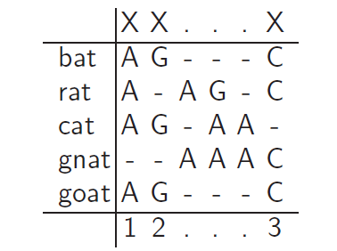
Topic II: Multiple Alignment

Slide 36
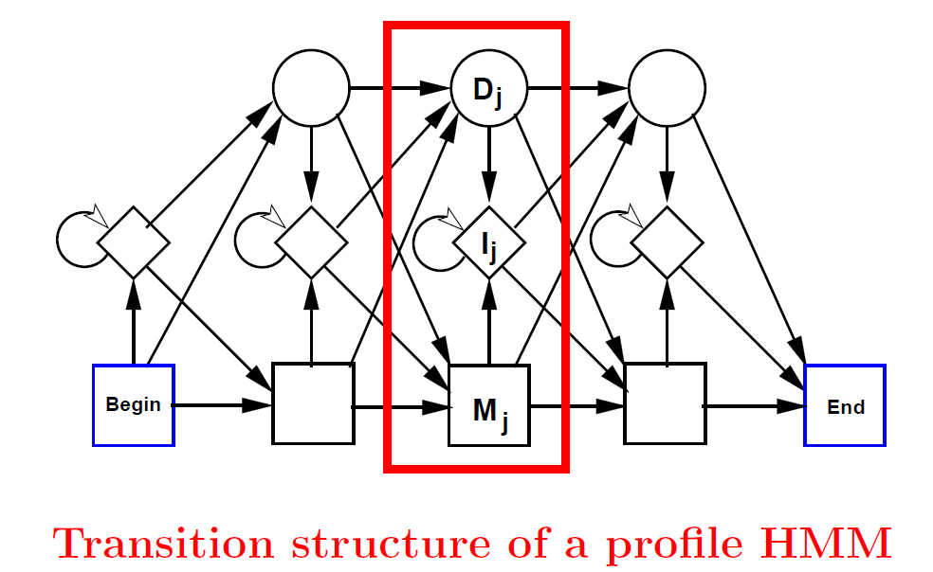
Profiled HMM

Slide 37
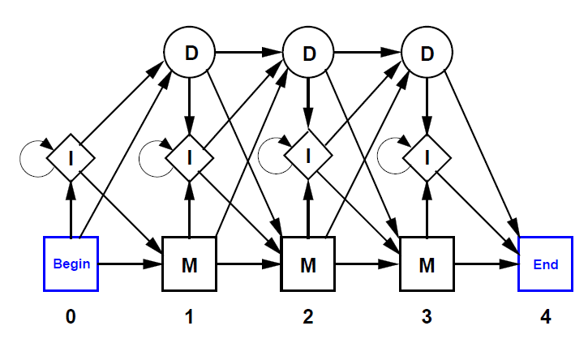
Example of Profile HMM

Slide 38
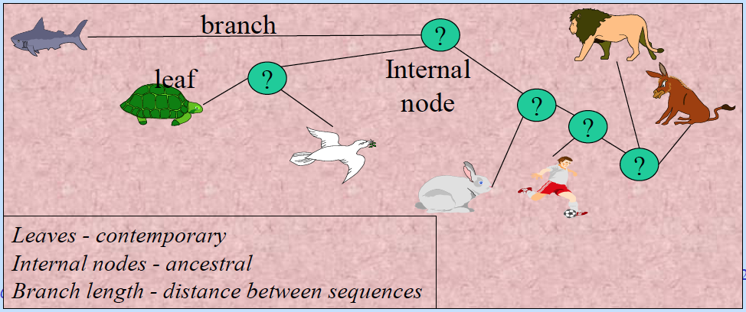
Topic III: Tree of lifes
Phylogeny: the ancestral relationship of a set of species
Represented by a phylogenetic tree

Slide 39
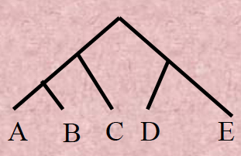
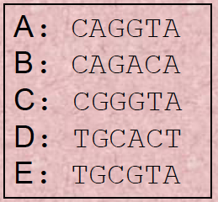
Inferring a phylogenetic tree
Classical: morphological characters
Modern: molecular sequences
Approaches: probabilistic model, bootstrap

Slide 40
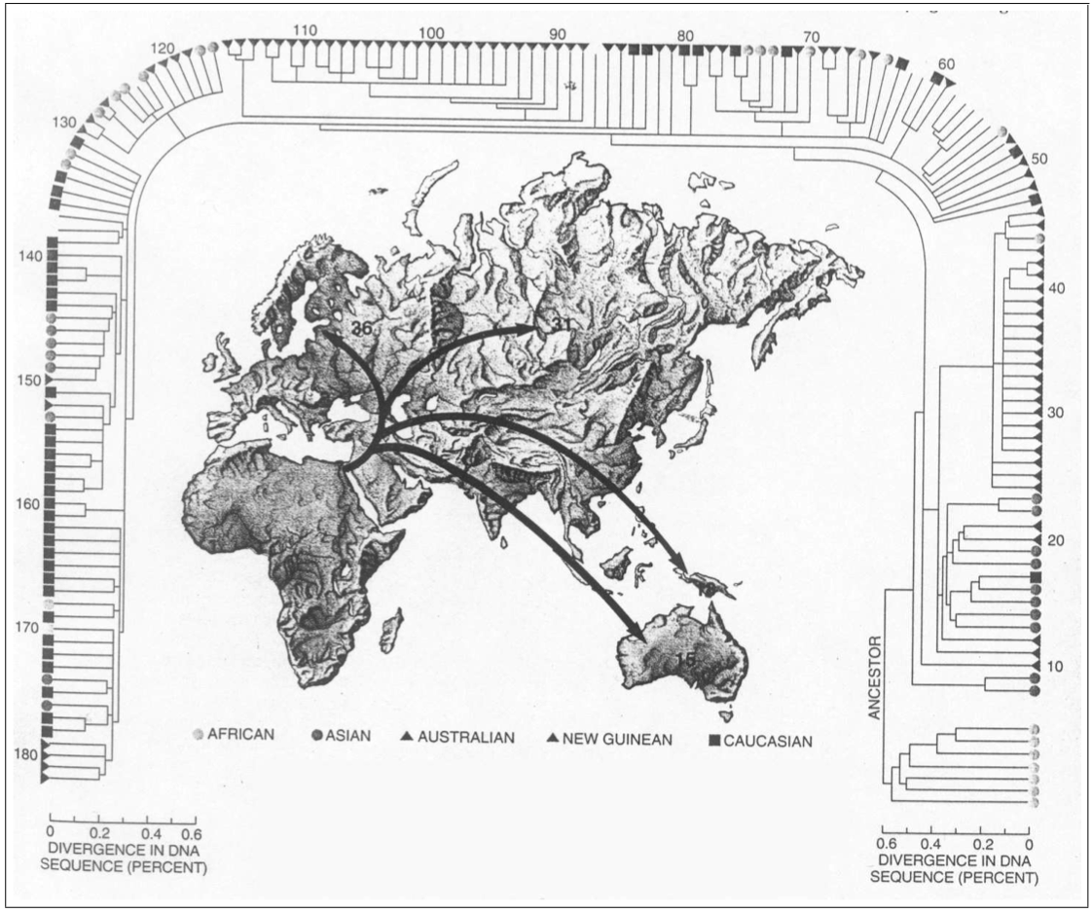
An example: Out of Africa

Slide 41
Topic IV: Motif Finding
Find promoter motifs associated with co-regulated or functionally related genes

Slide 42
Transcriptional Regulation
The transcription of each gene is controlled by a regulatory region of DNA relatively near the transcription start site (TSS).
two types of fundamental components
short DNA regulatory elements
gene regulatory proteins that recognize and bind to them.

Slide 43
Regulation of Genes
Transcription Factor
(Protein)
RNA polymerase
(Protein)
DNA
Regulatory Element
Gene
source: M. Tompa, U. of Washington

Slide 44
Regulation of Genes
Transcription Factor
(Protein)
RNA polymerase
DNA
Regulatory Element
Gene
source: M. Tompa, U. of Washington

Slide 45
Regulation of Genes
mRNA
RNA polymerase
Transcription Factor
DNA
Regulatory Element
Gene
source: M. Tompa, U. of Washington

Slide 46
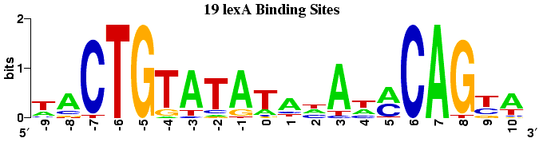
Motif Finding Problem
Characterizing the motif: Positional weight matrix
Finding the motif
Gibbs Sampler (AlignACE)
EM algorithm (MEME)

Slide 47
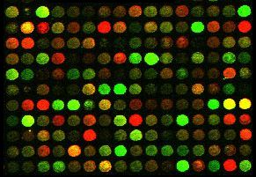
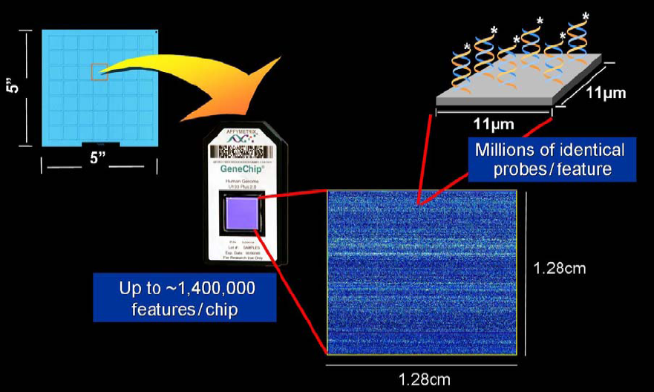
Topic V: Gene Expression Data Clustering and Biomarker Discovery

Slide 48
Microarrays
DNA microarray technology rely on the hybridization properties of nucleic acids to monitor DNA or RNA abundance on a genomic scale in different types of cells.

Slide 49
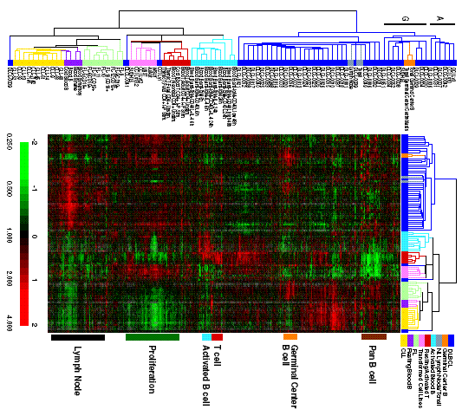
Alizadeh et al., Nature 403:503-11, 2000

Slide 50
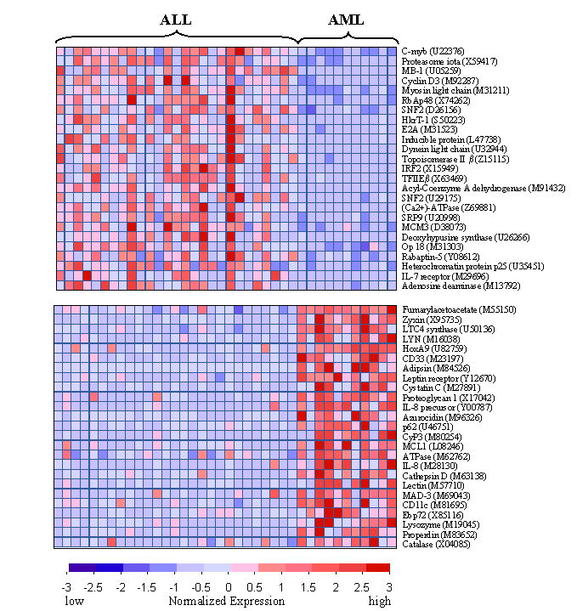
Classification
Given: the case, control gene expression data
Find: a set of genes (biomarker) can discriminate two classes.
Method: variable selection

Slide 51
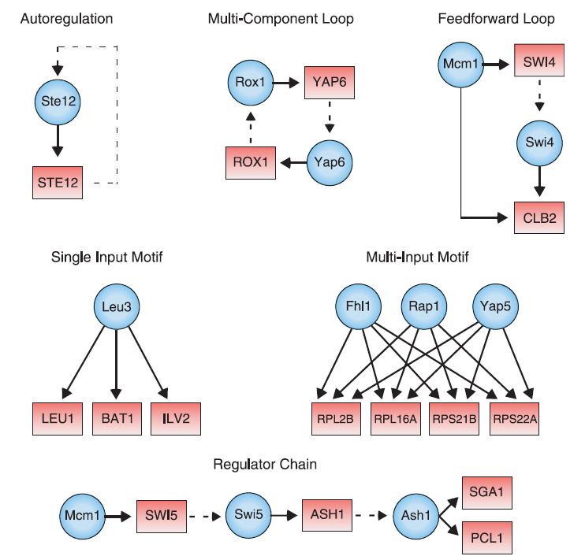
Topic VI: Regulatory Network Inference from Gene Expression Data
Lee et al. Science 298: 799(2002)

Slide 52
Network Inference: Reverse Engineering
Given: a large set of gene expression observations
Find:
Wiring diagram
Transition rules
To fit the observation data
Methods
Bayesian Network
Gaussian graphical model

Slide 53
Dream Project
DREAM: Dialogue for Reverse Engineering Assessments and Methods
http://www.the-dream-project.org/

Slide 54
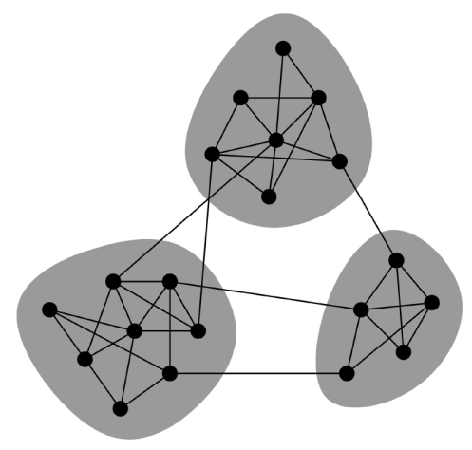
Topic VII: Network Analysis
Network modular (network clustering)

Slide 55
Network Motif
Definition: Patterns of interconnections occurring in complex networks at numbers that are significantly higher than those in randomized networks (Milo, R., et. al. Science 298, 824–827)

Slide 56
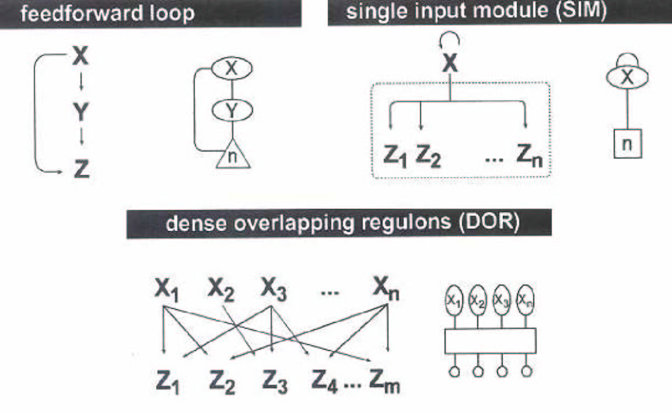
Network Motifs
Milo et al. Science, 298, 2002

Slide 57
Topic VIII: Dimension Reduction
Curse of dimensionality
Visualization in low dimension

Slide 58
Curse of Dimensionality
A major problem is the curse of dimensionality.
If the data x lies in high dimensional space, then an enormous amount of data is required to learn distributions or decision rules.
Example: 50 dimensions. Each dimension has 20 levels. This gives a total of cells. But the no. of data samples will be far less. There will not be enough data samples to learn.

Slide 59
Curse of Dimensionality
One way to deal with dimensionality is to assume that we know the form of the probability distribution.
For example, a Gaussian model in N dimensions has N + N(N-1)/2 parameters to estimate.
Requires data to learn reliably. This may be practical.

Slide 60
Dimension Reduction
One way to avoid the curse of dimensionality is by projecting the data onto a lower-dimensional space.
Techniques for dimension reduction:
Principal Component Analysis (PCA)
Singular value decomposition (SVD)
Multi-dimensional Scaling (MDS).

Slide 61
References
James D. Watson, Tania A. Baker, Stephen P. Bell. Molecular Biology of the Gene. Benjamin-Cummings Publishing Company. 2008.
Bruce Alberts. Molecular Biology of the Cell. Garland Publishing Inc. 2007.
Jocelyn E. Krebs, Stephen T. Kilpatrick, Elliott S. Goldstein. Lewin‘s Genes XI. Jones and Bartlett Publishers, Inc. 2012.

